Slide 1
Business recommendations - Men’s & Children’s Apparel
Brian Hudnall , Mason Wrolstad, Naga Soundari Balamurugan
March 8th, 2018

Slide 2
Agenda
During this presentation we will cover the following questions…
Recommend a marketing strategy for the overall Product Categories of Men’s Apparel and Children's Apparel, with details for Product Types. Which products / product types/ product category should be featured? What should be done in the next year to maximize the Product Category profits? How are they performing against target? Do you expect them to meet their 2014 target?
“Recommend separate 2013 and 2014 bonus amounts for the Product Categories if the total bonus pool for 2013 is $1,000,000 and the total bonus pool for 2014 is $2,000,000. Base your recommendation on how well the channel is meeting its target and also how well each reseller and online is meeting their individual sales targets.”
Assess product sales by day of the week for the two Product Categories. What can we learn about sales trends?
Analyze patterns in product sales (for products in Product Categories of Men’s Apparel and Children's Apparel) by channel and location. What can you learn?

Slide 3
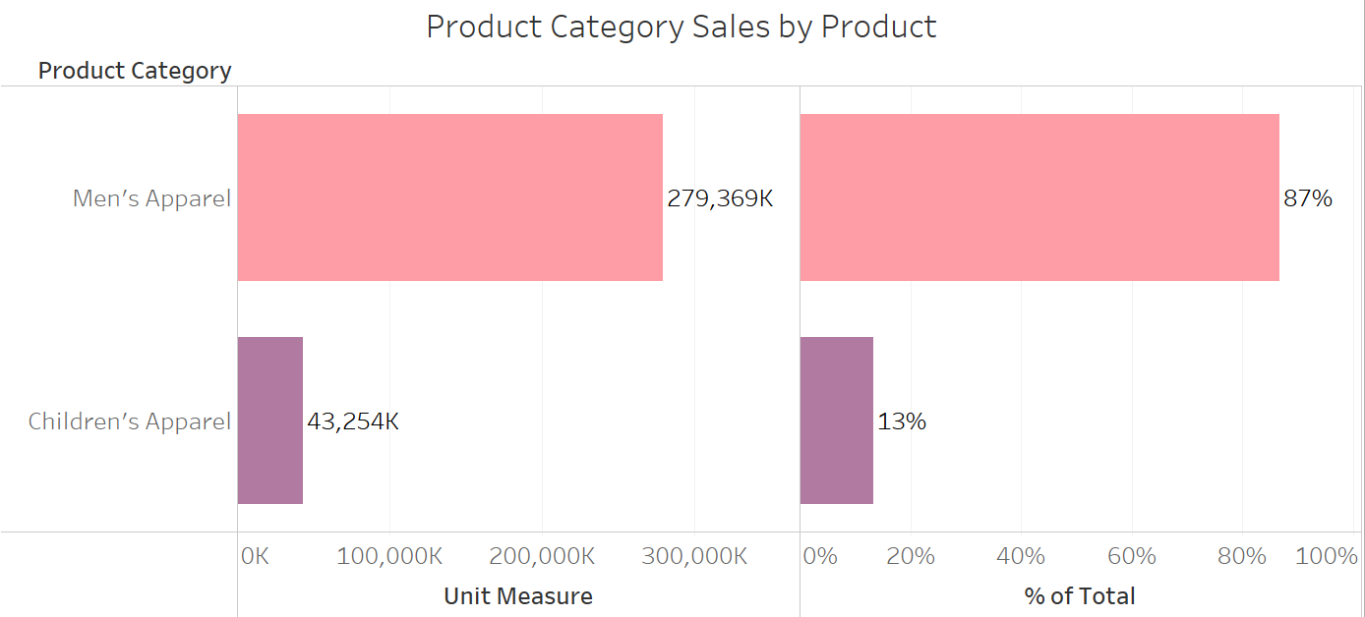
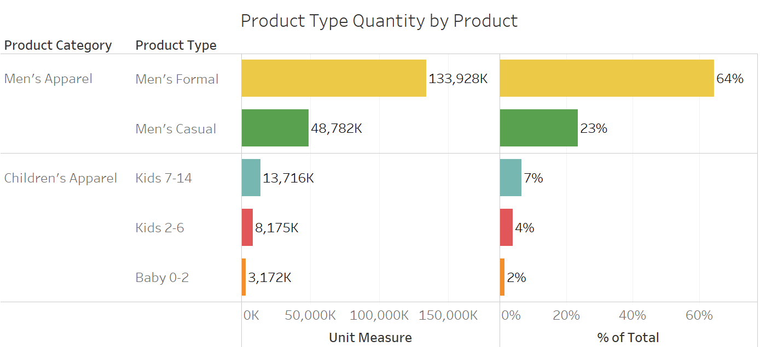
Recommend a marketing strategy for the overall Product Categories of Men’s Apparel and Children's Apparel, with details for Product Types. Which products / product types/ product category should be featured? What should be done in the next year to maximize the Product Category profits? How are they performing against target? Do you expect them to meet their 2014 target?
Looking at overall sales for both Men’s Apparel and Children’s Apparel, you can see that Men’s Apparel dominates our sales, profits, and quantity metrics. It makes up 87% of our sales in 2013, and 89% in 2014.
Diving in deeper, you can see that Men’s Formal Apparel makes up for 64% of the total sales quantity of all product types in 2013, and 67% in 2014. This is our biggest selling item.

Slide 4
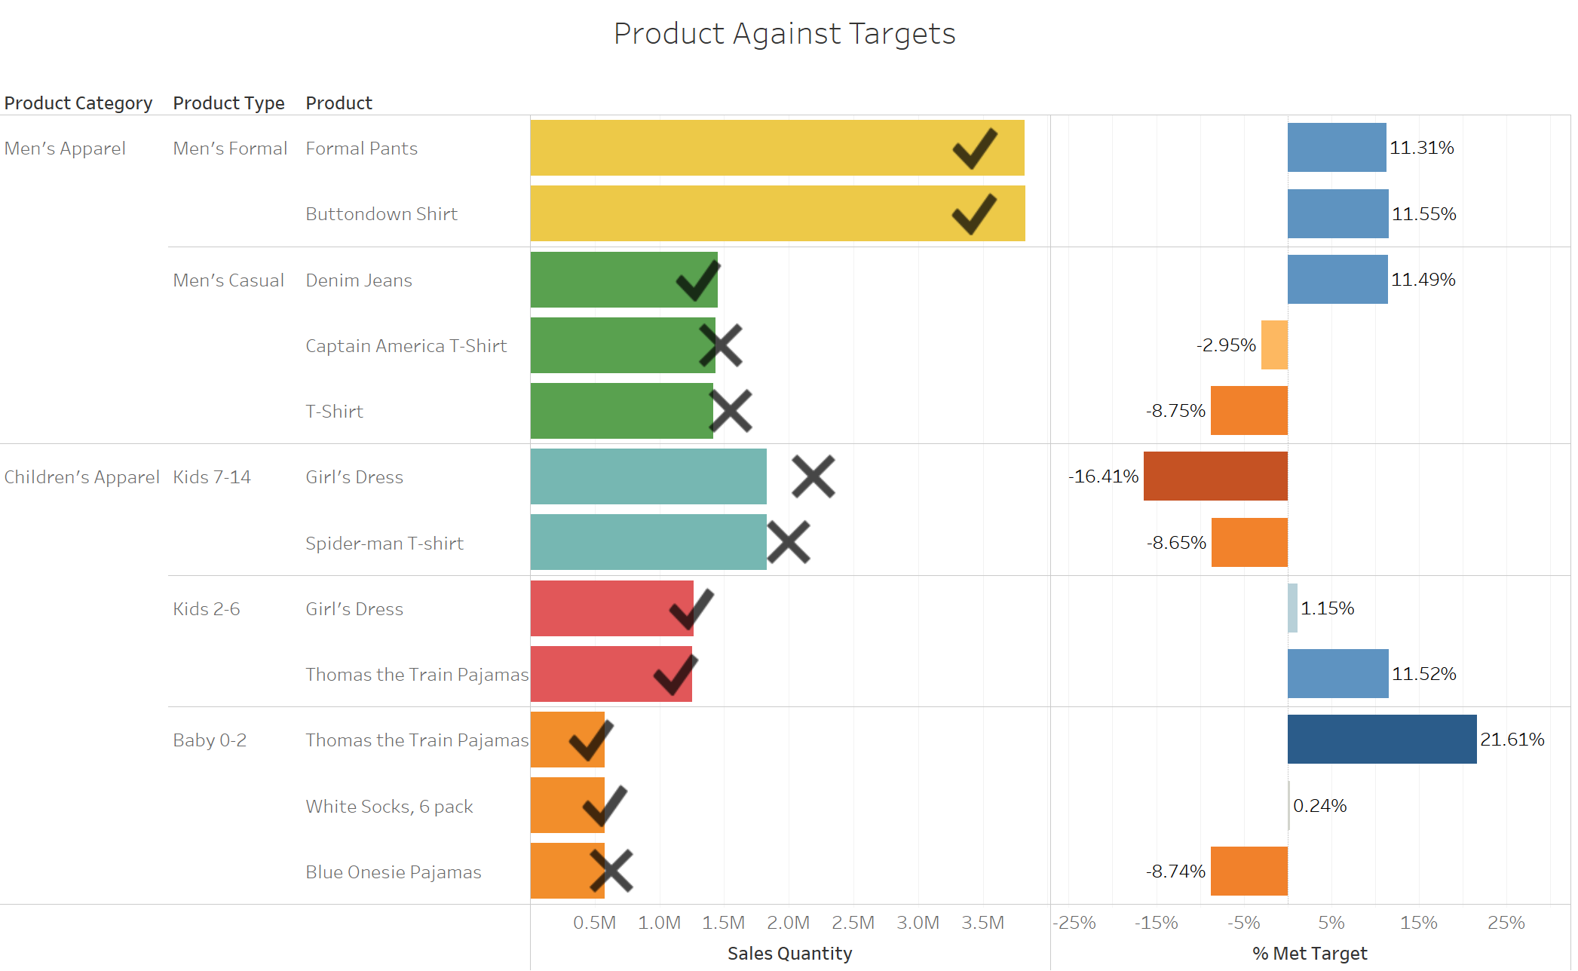
Recommend a marketing strategy for the overall Product Categories of Men’s Apparel and Children's Apparel, with details for Product Types. Which products / product types/ product category should be featured? What should be done in the next year to maximize the Product Category profits? How are they performing against target? Do you expect them to meet their 2014 target?
When taking a look at how the products are performed against target for 2013, you can see that the Men’s Formal Apparel did quite well. A few of the Children’s Apparel Products fell short.

Slide 5
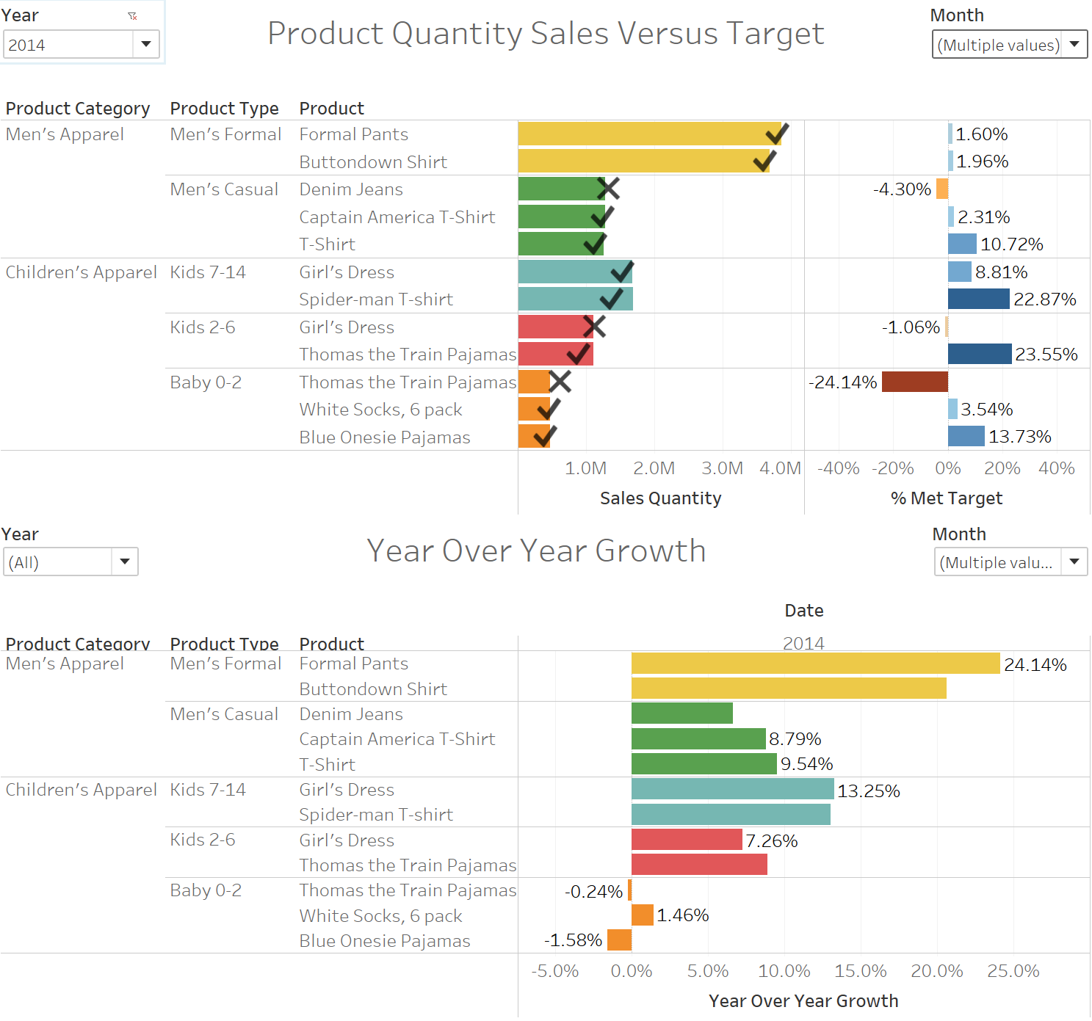
Recommend a marketing strategy for the overall Product Categories of Men’s Apparel and Children's Apparel, with details for Product Types. Which products / product types/ product category should be featured? What should be done in the next year to maximize the Product Category profits? How are they performing against target? Do you expect them to meet their 2014 target?
For 2014, when looking at performance against target, and observing the growth from 2013 to 2014, that most of the products are on track to hit their targets, and most are showing a healthy growth in sales
The only area we’re seeing a slow in growth, is Children’s Apparel (Baby 0-2). It appears that they are close to not hitting their target.
We suggest featuring the Children’s Apparel for Baby’s 0-2 in the next year to increase profits for that specific product category and type.

Slide 6
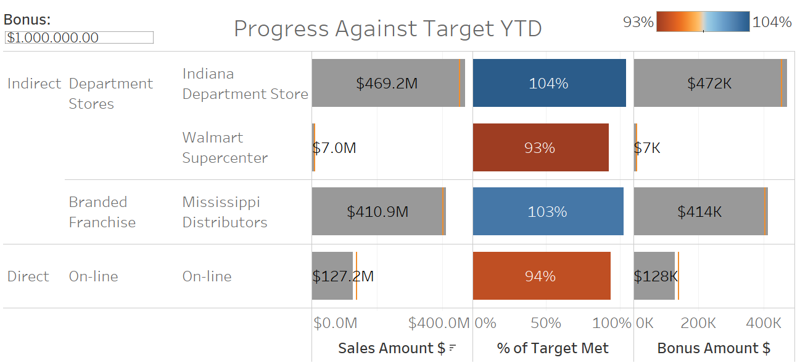
Recommend separate 2013 and 2014 bonus amounts for the Product Categories if the total bonus pool for 2013 is $1,000,000 and the total bonus pool for 2014 is $2,000,000. Base your recommendation on how well the channel is meeting its target and also how well each reseller and online is meeting their individual sales targets.
2013 Bonuses:
To determine the bonuses for each channel, we decided to set a “target bonus” amount that the channel would try to build up to. This represented the portion of sales that the channel represented out of the four total entities…
Channel | Bonus $ | Men’s Apparel % | Children’s Apparel % | Men’s Apparel $ | Children’s Apparel $
Indiana Department Store | $472K
Walmart Superstore | $7K
Mississippi Distributors | $414K
Online | $128K

Slide 7
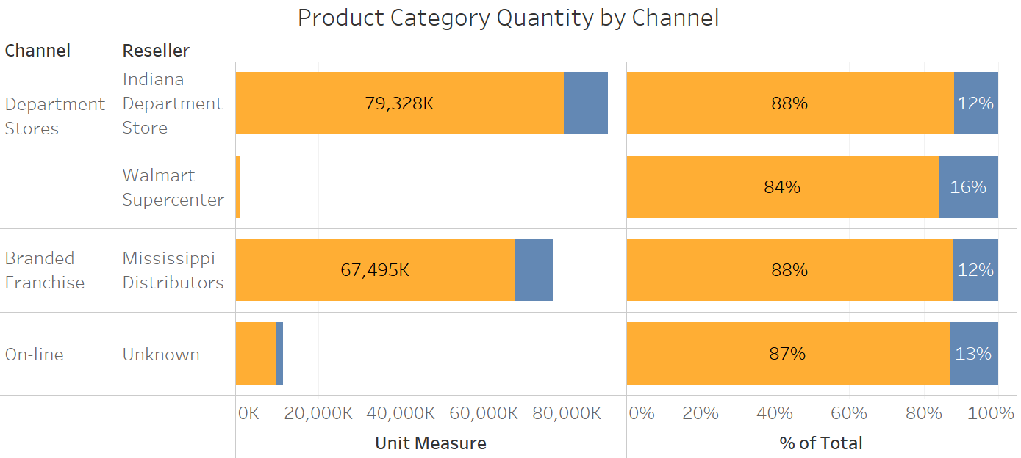
Recommend separate 2013 and 2014 bonus amounts for the Product Categories if the total bonus pool for 2013 is $1,000,000 and the total bonus pool for 2014 is $2,000,000. Base your recommendation on how well the channel is meeting its target and also how well each reseller and online is meeting their individual sales targets.
2013 Bonuses:
We then allotted the bonuses to the specific category managers at each store by taking the percentage of sales that their category represented out of Men’s Apparel and Children’s apparel and multiplied it by the Channel’s total bonus amount…
Channel | Bonus $ | Men’s Apparel % | Children’s Apparel % | Men’s Apparel $ | Children’s Apparel $
Indiana Department Store | $472K | 88% | 12% | $415K | $57K
Walmart Superstore | $7K | 84% | 16% | $5.88K | $1.12K
Mississippi Distributors | $414K | 88% | 12% | $364K | $50K
Online | $128K | 87% | 13% | $111K | $17K

Slide 8
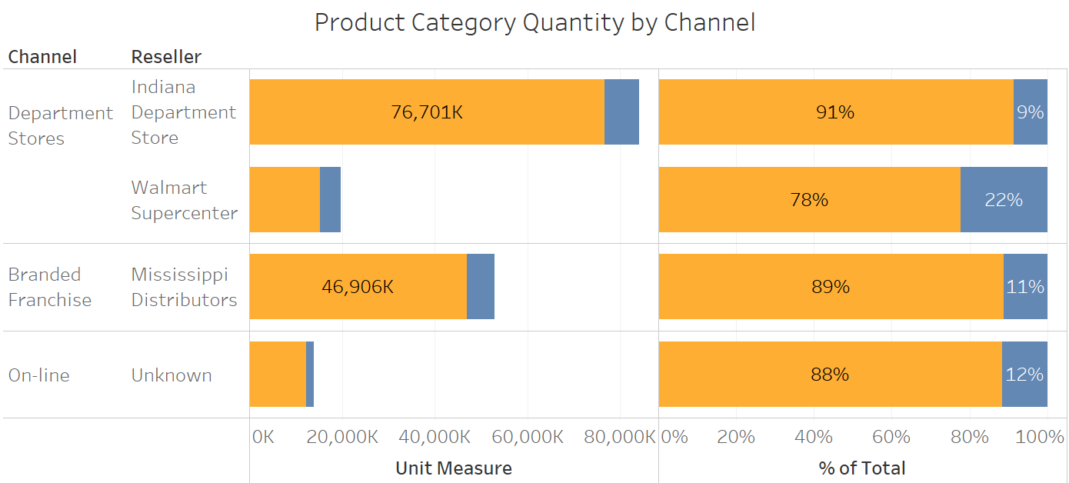
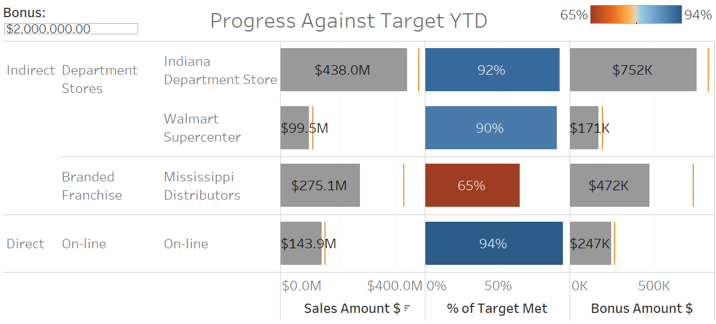
Recommend separate 2013 and 2014 bonus amounts for the Product Categories if the total bonus pool for 2013 is $1,000,000 and the total bonus pool for 2014 is $2,000,000. Base your recommendation on how well the channel is meeting its target and also how well each reseller and online is meeting their individual sales targets.
Repeat for 2014 Bonuses:
Channel | Bonus $ | Men’s Apparel % | Children’s Apparel % | Men’s Apparel $ | Children’s Apparel $
Indiana Department Store | $752K | 91% | 9% | $684K | $68K
Walmart Superstore | $171K | 78% | 22% | $133K | $38K
Mississippi Distributors | $472K | 89% | 11% | $420K | $52K
Online | $247K | 88% | 12% | $217K | $30K

Slide 9
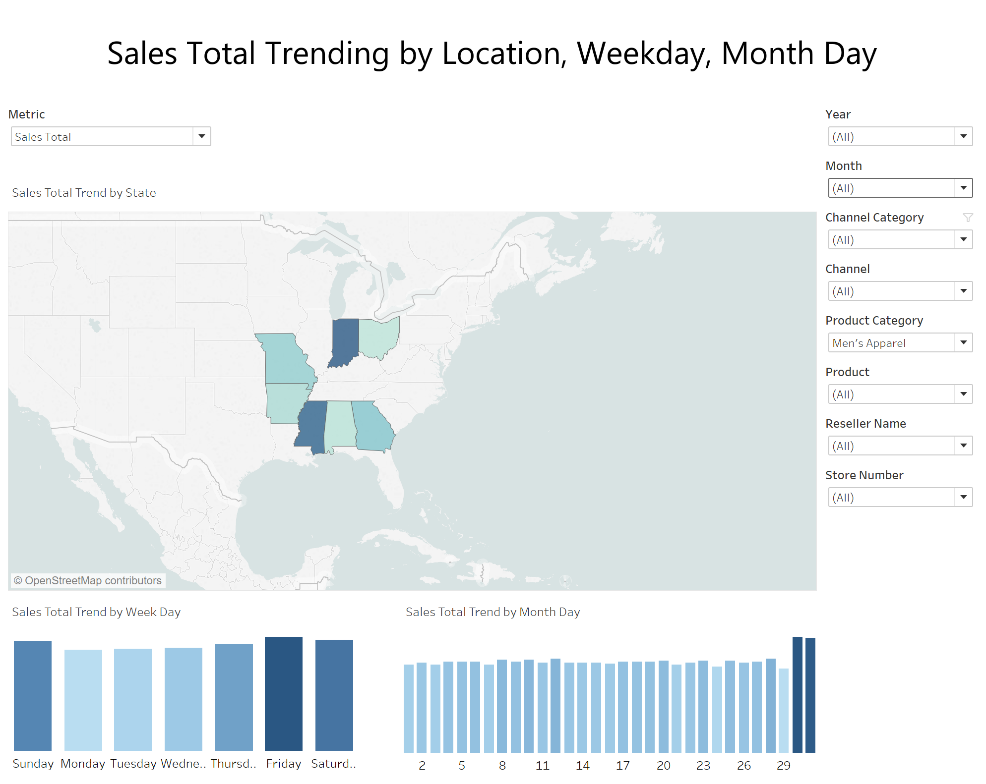
Assess product sales by day of the week for the two Product Categories. What can we learn about sales trends?
Men's Apparel purchases are strongest on the weekend. In particular for Boutique's and Outlet stores. The highest selling item is Button-down shirts (Also the highest profit margin) so it's most likely a purchase for work or for a special occasion. Inversely, Online sales are strongest during the week.
Depending on the marketing strategy, it would make sense to provide online deals for these items during the week. Digital deals also provide the opportunity for customized messaging and more efficient targeting rather than offline mass deals.
Children's clothing does not have a consistent trend for sales by week day, there are seasonal changes potentially depending on changes in school schedule.
Outside of the holiday season (Oct - Jan) Sales are highest at the end of the month for both the Men's and Children's category, most likely due to discounts, or deals for the purpose of hitting sales targets.

Slide 10
Analyze patterns in product sales (for products in Product Categories of Men’s Apparel and Children's Apparel) by channel and location. What can you learn?
For the Direct Channel Category, Men's and Children's Apparel sales are strongest in Missouri and Georgia; with Georgia leading overall primarily due to Online and Boutique store sales.
For Indirect Sales during 2014, the Indiana Department Store leads all Resellers and is more than the two Mississippi reseller sales combined.
From 2013 to 2014 the Mississippi Branded Franchise had a major decline in sales YoY (-31%)

Slide 11
Final Recommendations
To recap our strategy, we suggest…
Feature Children’s Apparel, specifically for Baby’s between ages 0 and 2.
- While all other products are seeing a healthy growth in sales, this particular product category seems to be stagnant
- Offer coupons for Children’s Apparel in combination with the sale of Men’s Apparel
Add more products to the Men’s Apparel line
- The demand and sales are high, so more products would work
Provide an incentive to get people into stores during the week, and online during the weekend.
- Feature sales on targeted items, such as the Children’s Clothes mentioned above.
Follow our bonus recommendation for the channels eligible for bonuses on a yearly basis

